Slide 1
Tic-Tac-Toe Implementing MiniMax Algorithm
Team members:-
Vaishnavi Salaskar (vsala2@unh.newhaven.edu)
Vedant Chidgopkar (vchid2@unh.newhaven.edu)
Jeel Shah
(jshah14@unh.newhaven.edu)
Prof. Shivanjali Khare

Slide 2
Objective: -
The objective of this project is to build a TIc-Tac-Toe game using python and Minimax Algorithm with AI. The game is user friendly and optimized for performance.
The overall goal of this project is to showcase how minimax algorithm is used to build this game.

Slide 3
Introduction: -
To achieve the project objectives, we used Python programming language and implemented the Minimax algorithm to create the AI opponent for the Tic Tac Toe game.
We have created a user-friendly interface using Python libraries such as random, pickle, cv2, numpy.
If either the player of the AI agent wins, then an imaginary line will form connecting 3 same symbols (horizontal, vertical, or diagonal).
Losing condition is if no combination is formed until all the cells in the grid is full.

Slide 4
Tools and Libraries:-
Visual Studio Code
Python
OpenCV
Random
Pickle
numpy

Slide 5
Features: -
Random symbol assignment.
User-friendly input.
Score calculation and display.
Animated match display.
Turn indication.
Draw handling.
Persistent score storage.
Reset feature.
Quit option.

Slide 6
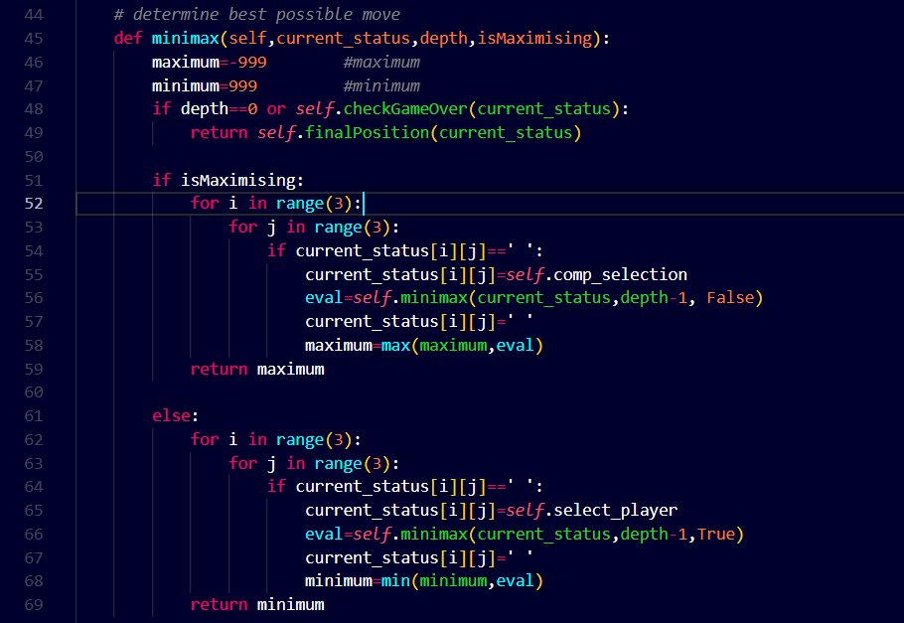
Minimax Algorithm

Slide 7
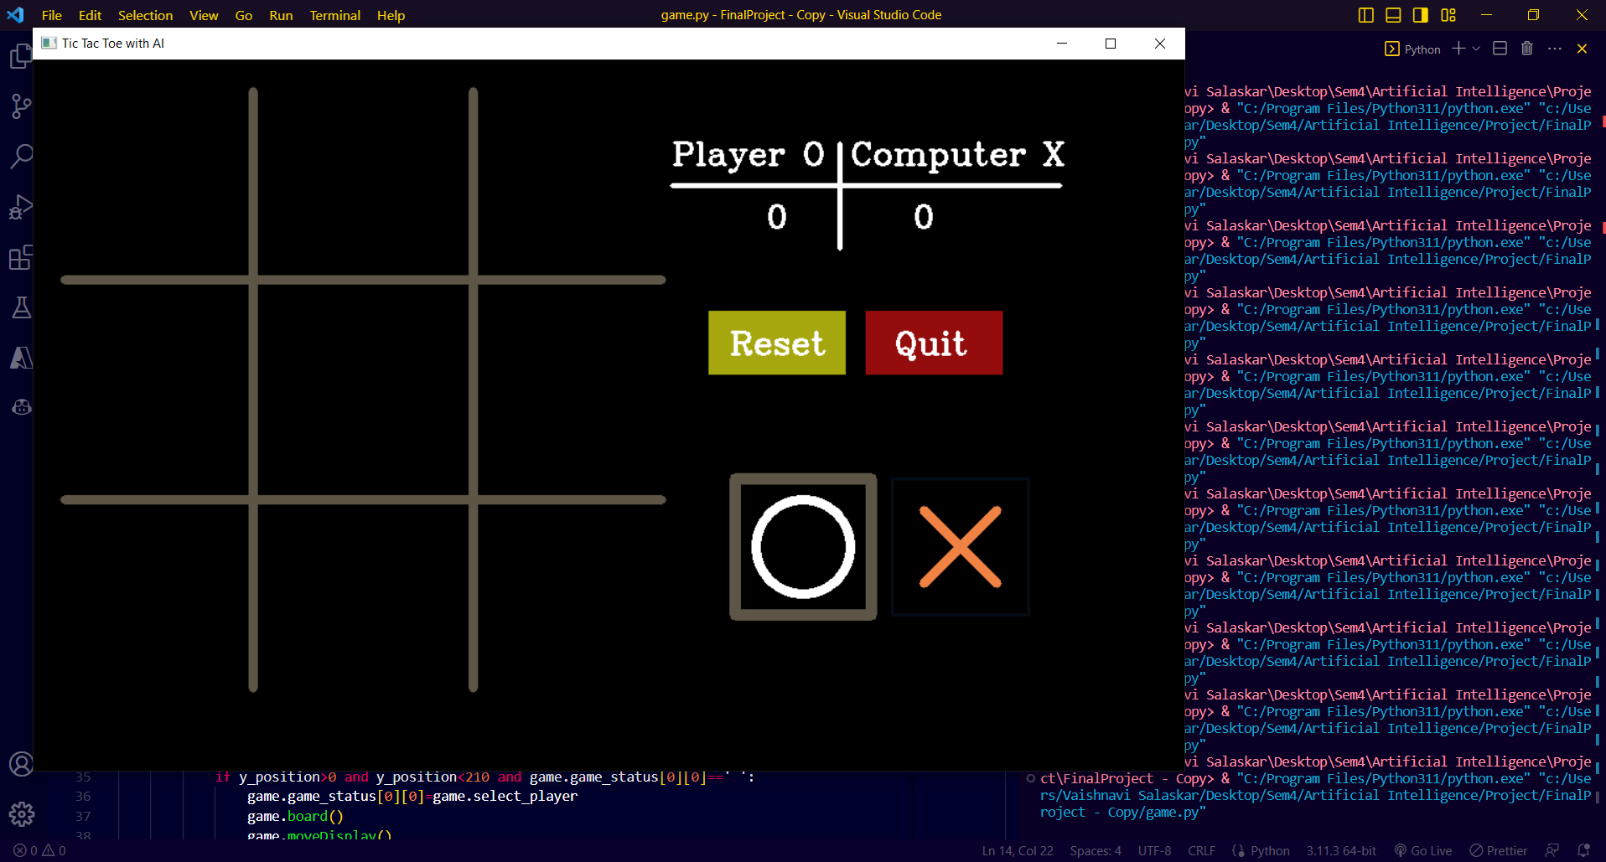
Output: Initial Stage

Slide 8
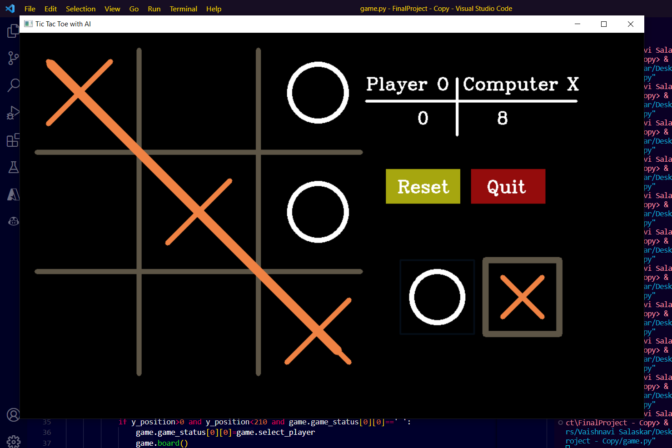
Output: Diagonal Line

Slide 9
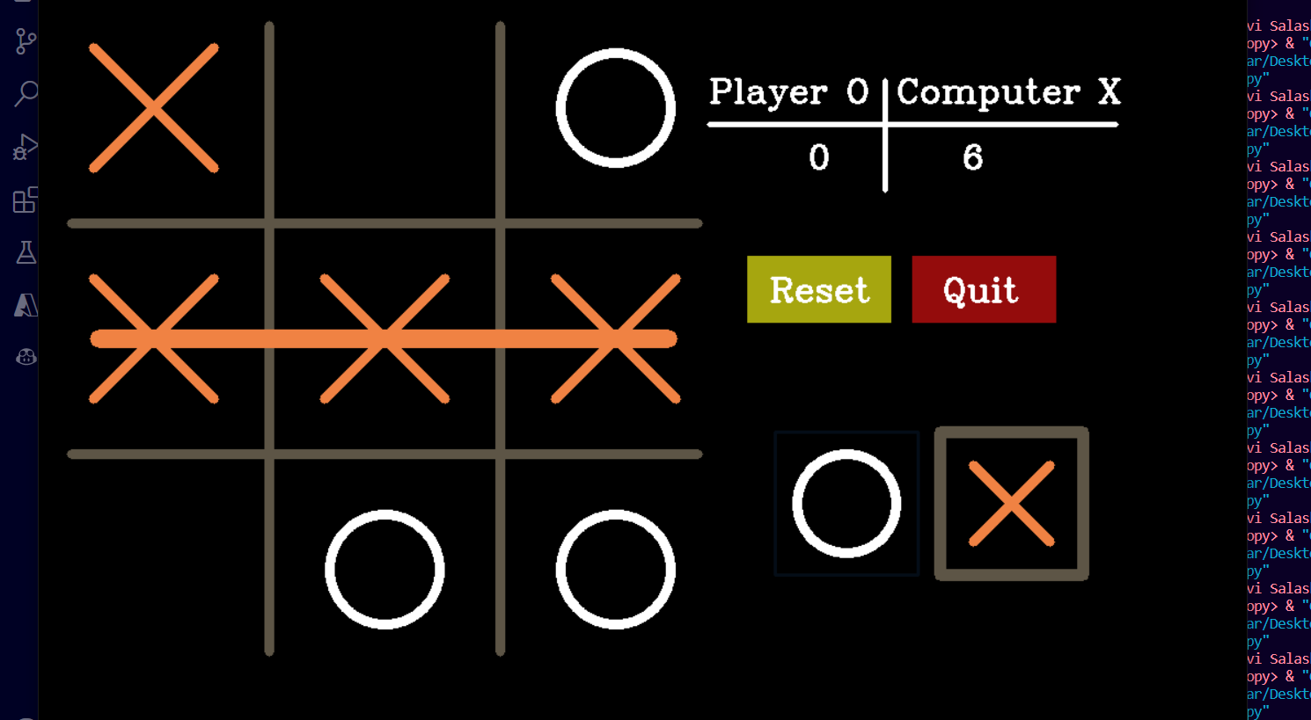
Output: Horizontal Line

Slide 10
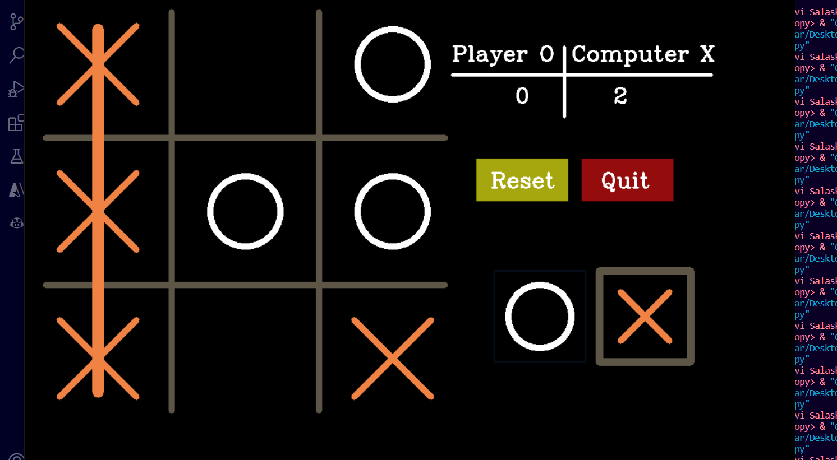
Output: Vertical Line

Slide 11
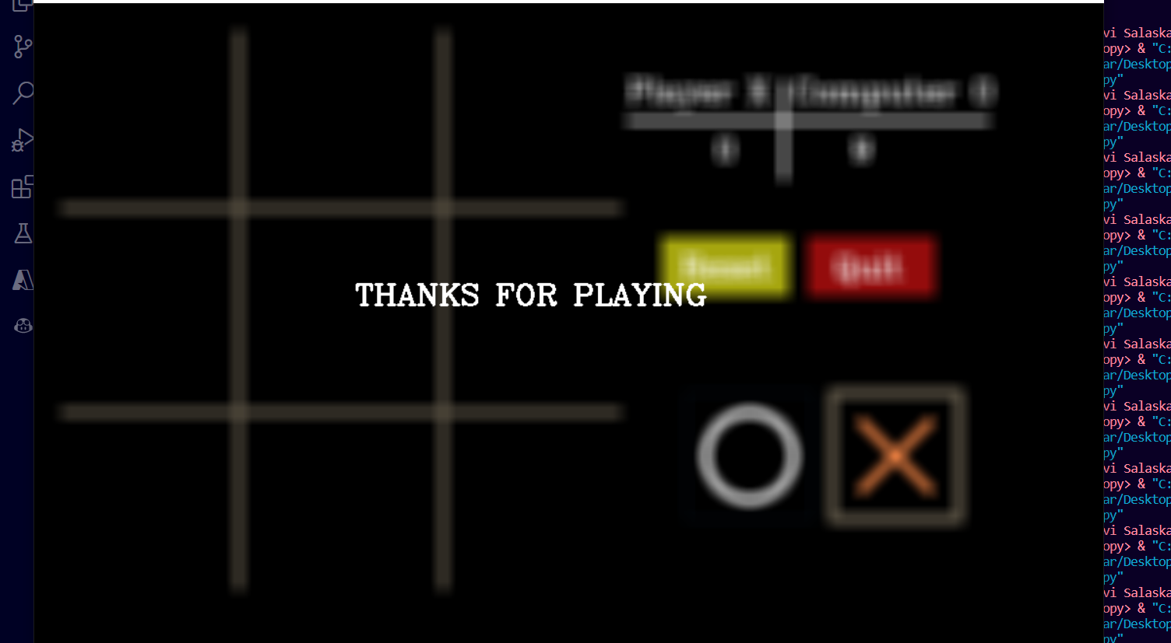
Output: Quit Game

Slide 12
Thank You

